Slide 1
The Ariba Network
Bidding for a Sourcing Event

Slide 2
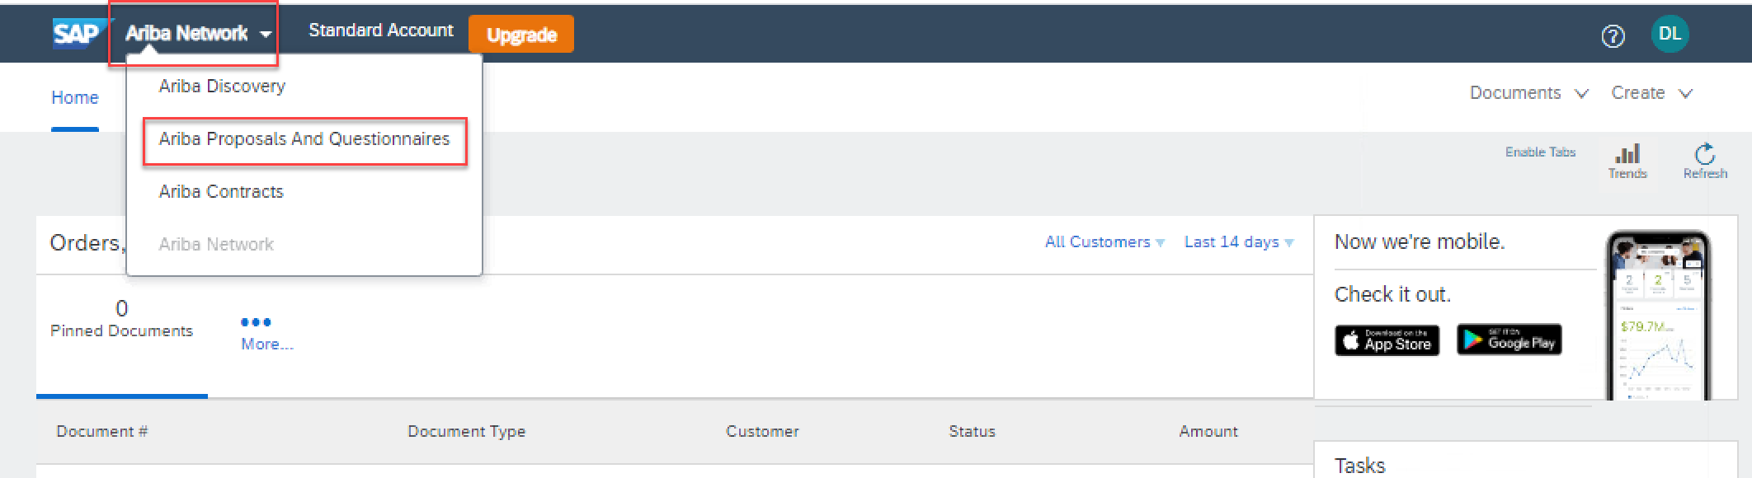
Supplier Registration Workshop
Bidding for a Sourcing Event
Step1: To toggle from the Purchase Orders interface to the Sourcing interface
Go to supplier.ariba.com and log in using your Ariba account credentials
On top left, click on the arrow next to “Ariba Network” and choose “Ariba Proposals and Questionnaires”
You will be directed to the Sourcing interface

Slide 3
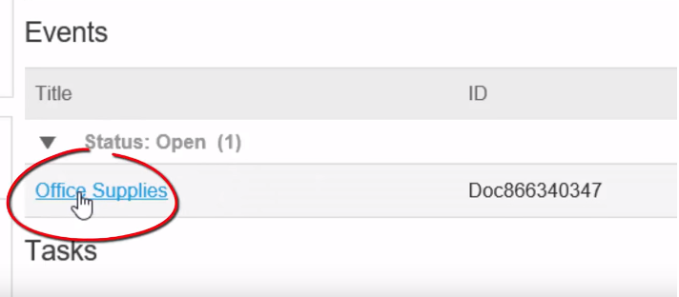
Supplier Registration Workshop
Bidding for a Sourcing Event
Step 2
Select the ‘Open Proposal’

Slide 4
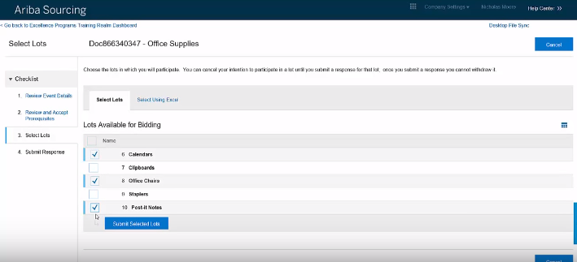
Supplier Registration Workshop
Bidding for a Sourcing Event
Step 3
Choose what to bid on

Slide 5
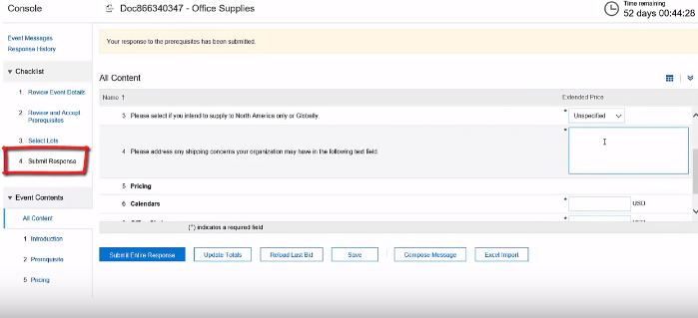
Supplier Registration Workshop
Bidding for a Sourcing Event
Step 4
Submit your response

Slide 6
Ariba Network Guidance
Support Available
If you have difficulties, and require technical support, you can access the Ariba Supplier Support Website on this link: https://www.ariba.com/support/supplier-support.
The Getting Started Page offers guidance on how to set up and navigate your new Ariba Network Account: https://www.ariba.com/ariba-network/ariba-network-for-suppliers/getting-started
The Ariba Network Quick Start Guide gives helpful instructions on how to use the service. Your SCI contact will provide you with a copy of this guide.

